Slide 1
Investigating Stylized Facts in Assets Returns
Using python

Slide 2
How did I do it
I used Python to extract S&P 500 data from Yahoo
The time period was between 01May1990 to 31May2020
The inspiration of this analysis was the book Python for Finance Cookbook by Erik Lewinson
The jupyter notebook is also available at https://github.com/IQisFisco/Stylized-Facts-for-Assets-Returns

Slide 3
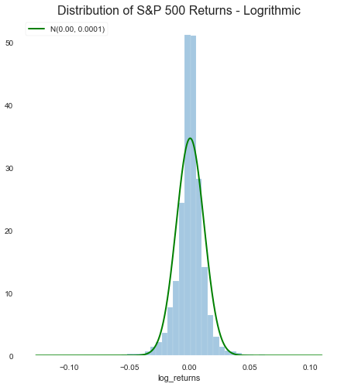
Fact #1: The returns are not normally distributed
The S&P 500 logarithmic returns are not normally distributed
The left tail is heavier indicating that negative return are more frequent

Slide 4
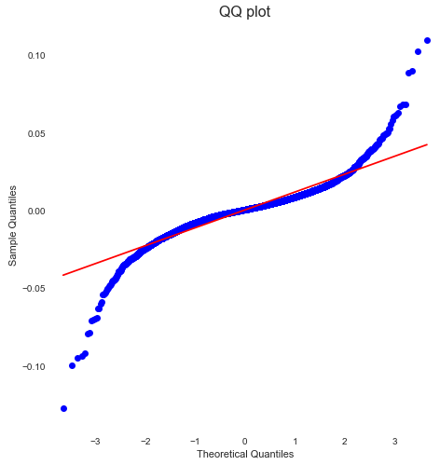
Fact #1: The returns are not normally distributed
The QQ plot of S&P 500 logarithmic returns further corroborates this fact
Both the ends of the line are significantly away from the red line – indicating very extreme outliers

Slide 5
Fact #1: The returns are not normally distributed
The most significant test of checking normality in python is Jarque-Bera test
Jarque-Bera statistic is 42176.121 with p-value of 0.000
Since the p value is less than 0.05 we can safely reject the null hypothesis that that S&P 500 returns are normally distributed

Slide 6
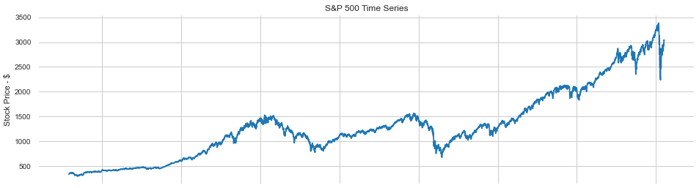
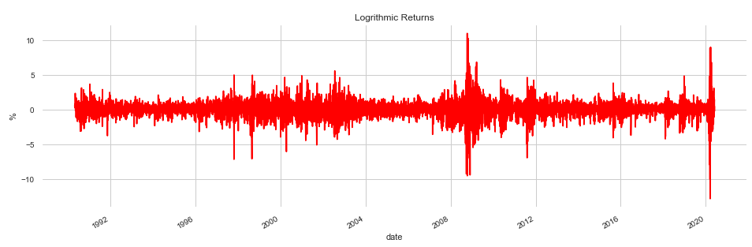
Fact #2: Volatility occurs in clusters
The first plot is adjusted closed prices
The second plot is of the logarithmic returns
The windows indicate two sample areas of volatility. Note that both areas are accompanied by more blotches of volatility

Slide 7
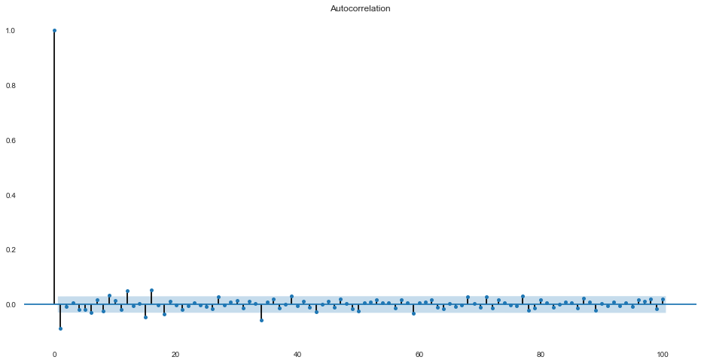
Fact #3: There is no autocorrelation in logarithmic returns
Autocorrelation of returns is associated with time series analysis with a certain lag
Most of the points in this 100 day lag autocorrelation are in the significance zone indicated by blue shading
All the points are around 0 indicating no correlation

Slide 8
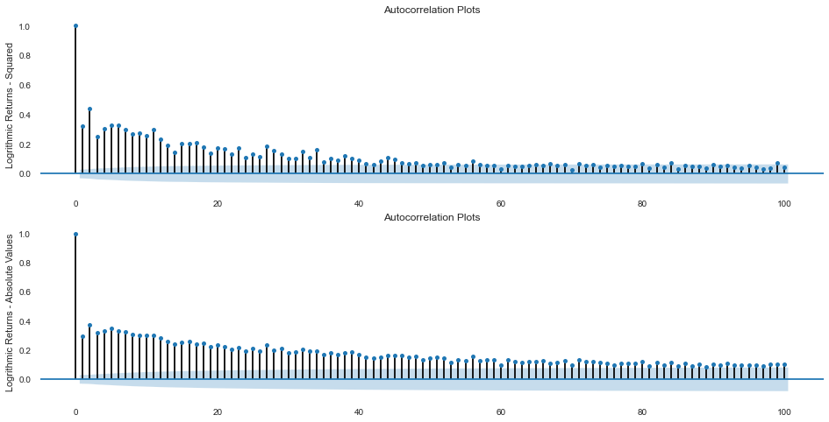
Fact #4: Squared or absolute logarithmic returns produce small and decreasing autocorrelations
The first graph is of the squared values of logarithmic returns
The bottom graph is of absolute logarithmic returns
Squaring or taking the absolute values allows for the easier interpretation of values from mean
Simple logarithmic returns are either negative or positive which complicates decision making – how far away they are from mean

Slide 9
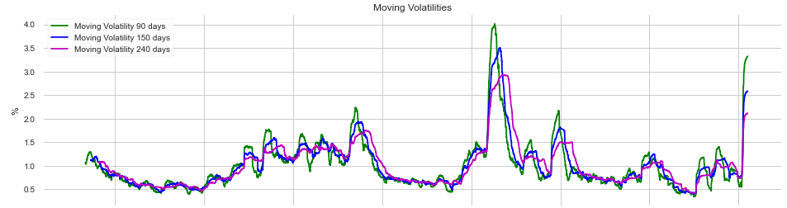
Fact #5: Volatility and increasing returns are inversely related
As highlighted in the two windows, increasing prices lead to declining or reduced volatility
Note the declining prices after 2008 lead to increased volatility

